Slide 1

Hindu Institute of Management
Juned (19012041019)
for the award of the degree
of Bachelor of Computer Application
Hindu Institute of Management
Hindu Institute of Management, Near Railway Station Road, Rohtak Road, Sonepat – 131001 Delhi - NCR
Mobile :- 08901440704 , 08901440705

Slide 2
Presenting
The Secret Power
Freedom of Thoughts

Slide 3
"Freedom is not worth having if it does not include the freedom to make mistakes"
Mahatma Gandhi

Slide 4
Why the Secret
Objectives
Methodology
Tools and technologies
Testing / Experimentation
Data collection / Data analysis
Findings and results
Applications
Conclusion
Future scope
References
Overview

Slide 5
Freedom of thoughts: Freedom of the thoughts is the biggest power in the world, Doesn't matter who you are?, where are you?
Throw out lies: Sometimes we are suppressed by the people who have more power, Who have more money. But our community will welcome everyone. Everywhere, Every time they share their thoughts without any fear.
Why The Secret?
What are the objectives?

Slide 6
Benjamin Franklin: Without freedom of thought, there can be no such thing as wisdom - and no such thing as public liberty without freedom of speech.
Tom Smothers: Freedom of expression and freedom of speech aren't really important unless they're heard. The freedom of hearing is as important as the freedom of speaking.
Larry Flynt: Privacy is not explicitly spelled out in the Constitution as freedom of speech is in the First Amendment.
Literature Review?

Slide 7
Create Account: Create account using Email ID or Phone Number.
Post Anonymousely: Share your thoughts anonymously.
Admit Proofs: Now you have the power to share your views on any organisation, people, place with the proof
Methodology?

Slide 8
CodeWithHaryy: Simply Easy Learning at your fingertips. Website providing courses at free of cost.
GeeksforGeeks: is providing amazing School Courses to all the young ones or school students. These specifically and carefully crafted interactive kids courses
W3 Schools: Learn to Code With the world's largest web developer site.
References?

Slide 9
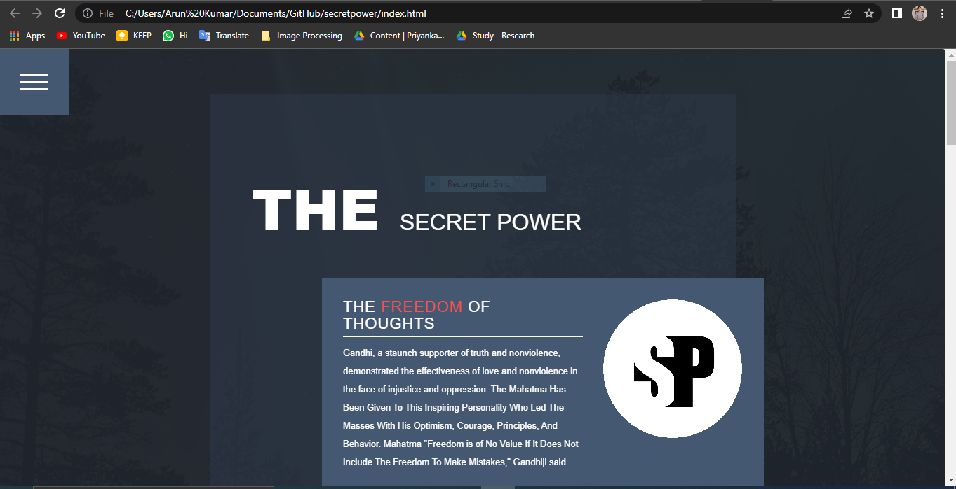
Front End

Slide 10
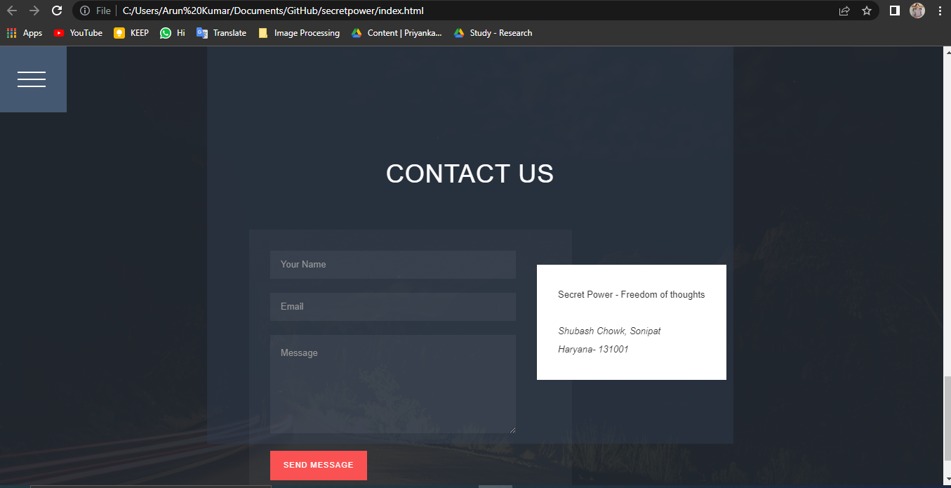
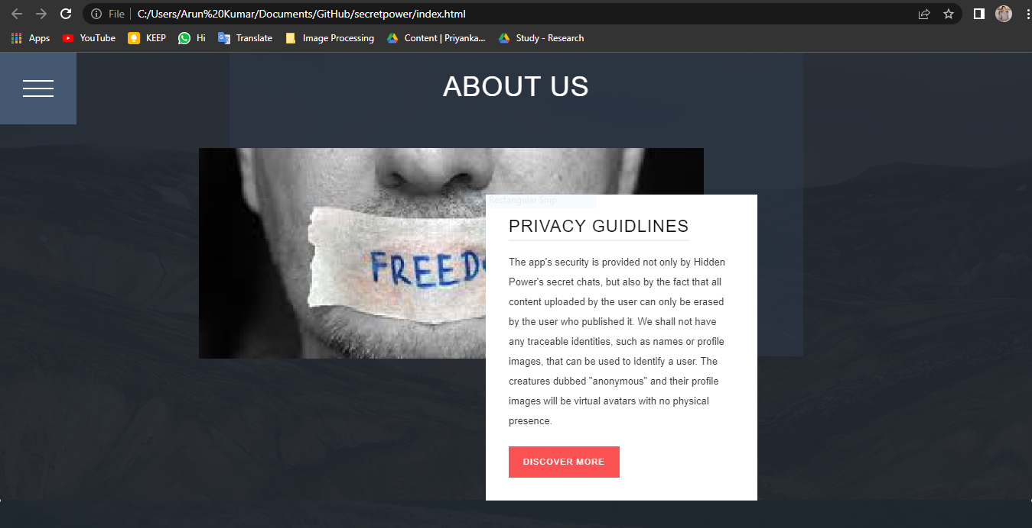
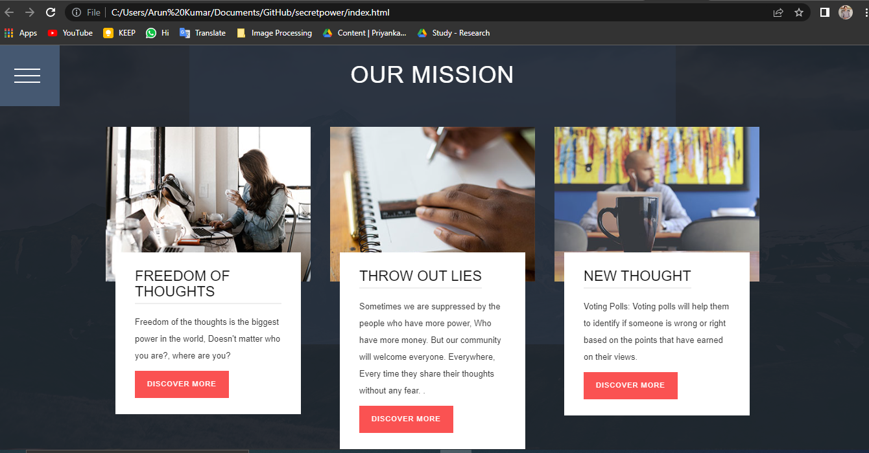

Slide 11
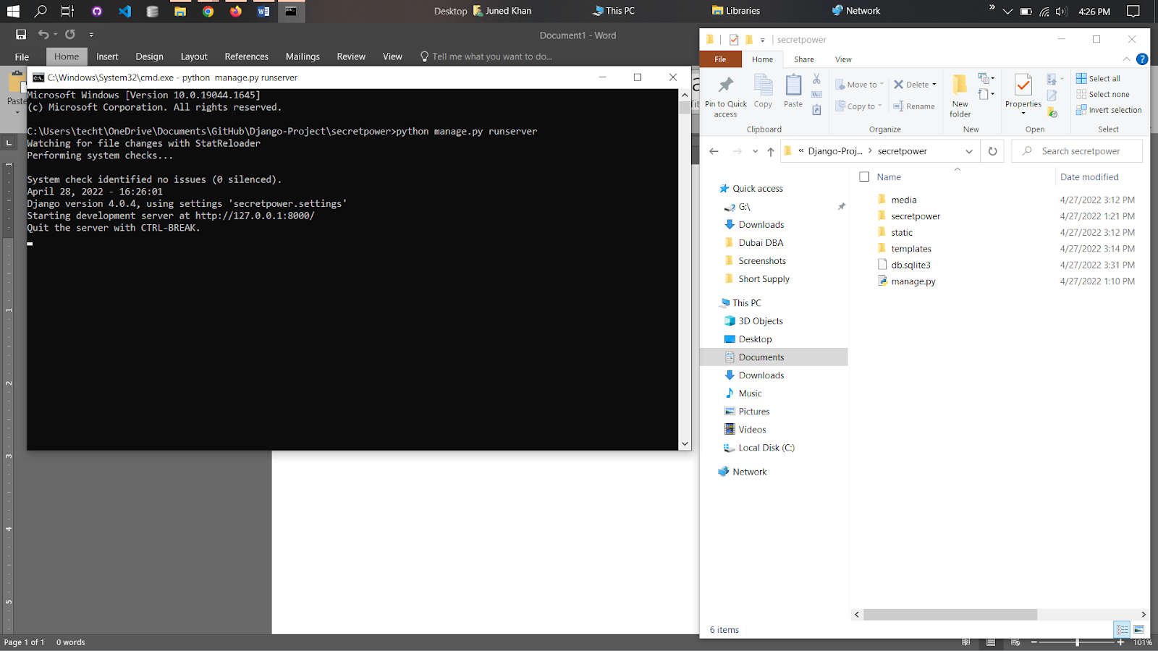
Back End

Slide 12
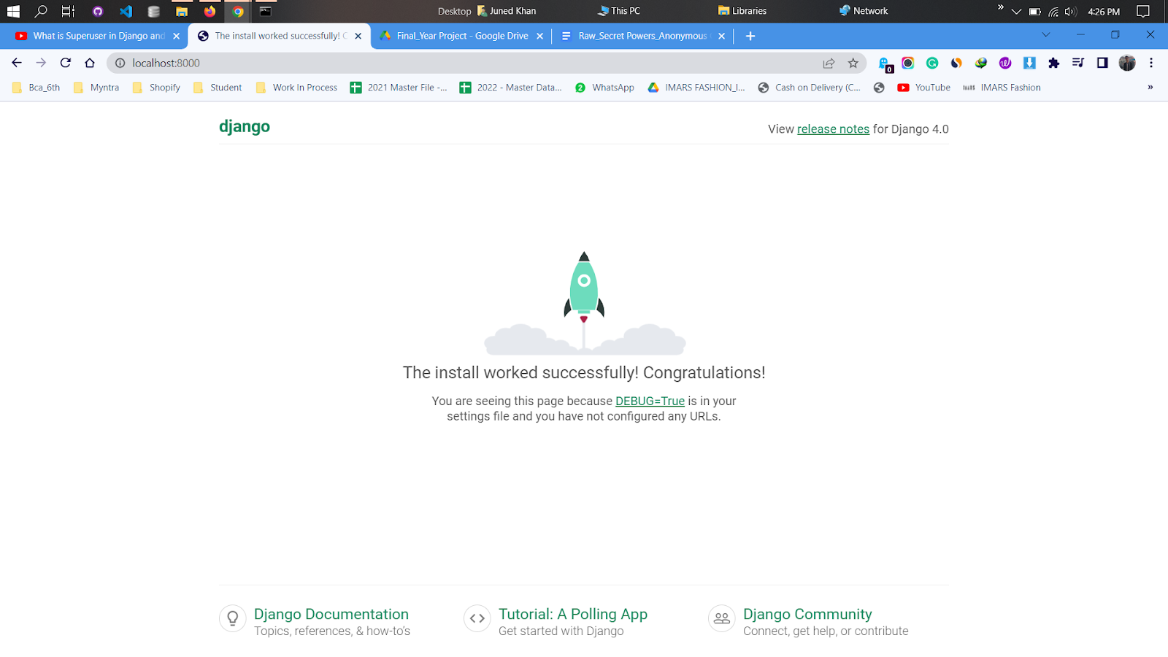
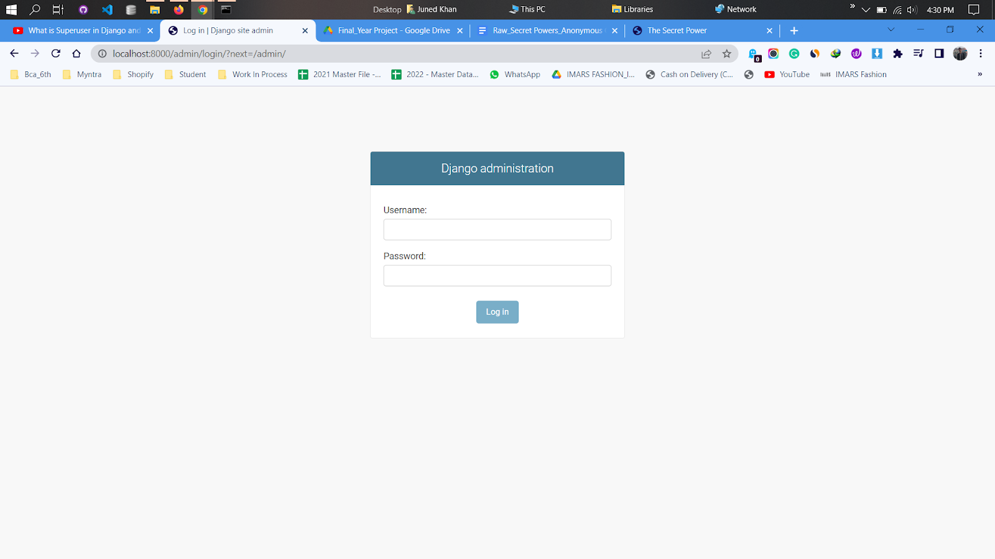
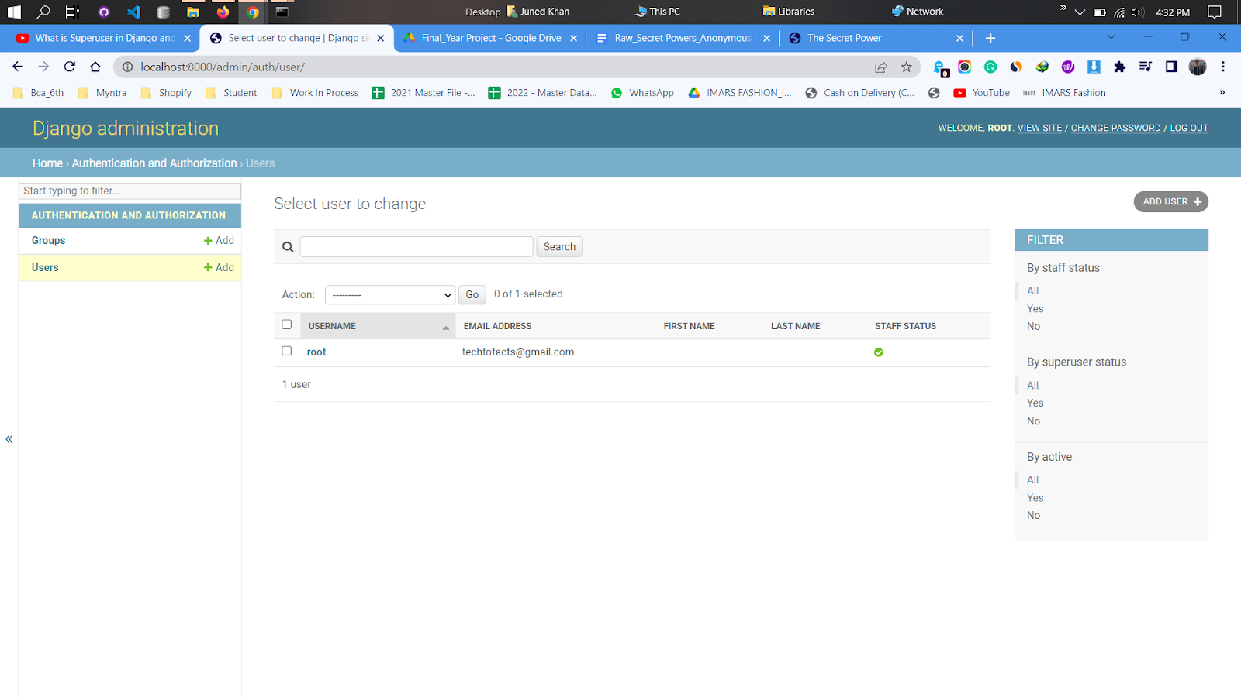
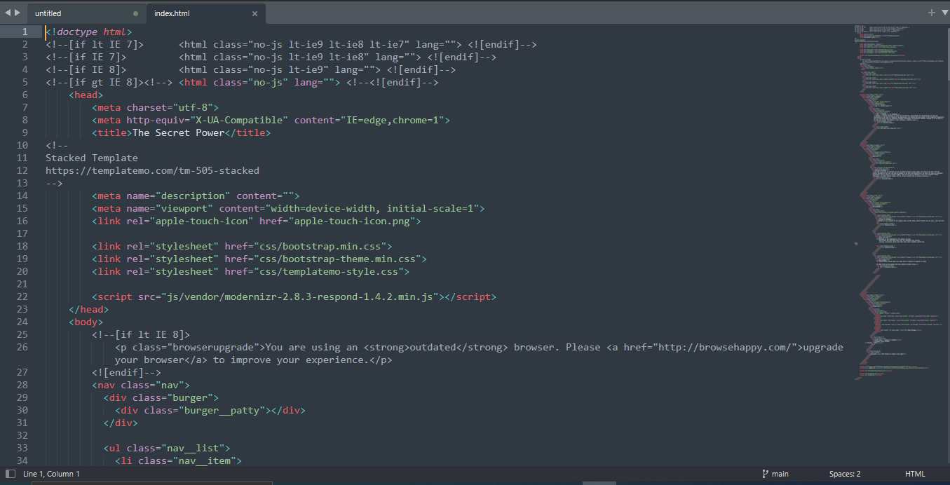

Slide 13
Thank You

